Slide 1

Understanding Customer Churn & Retention
Objective: To understand customer churn and identify strategies for improving retention

Slide 2

Contents
Who Are Our Customers?
Who’s Leaving?
Why Are They Leaving?
Who’s Staying?
Summary

Slide 3
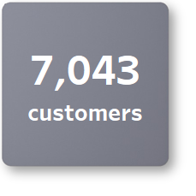
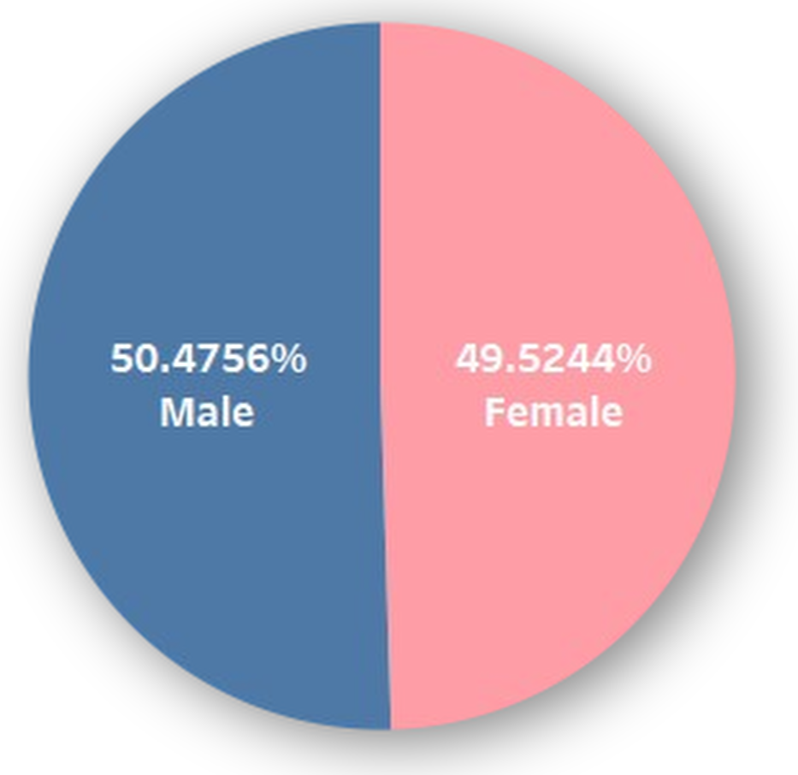
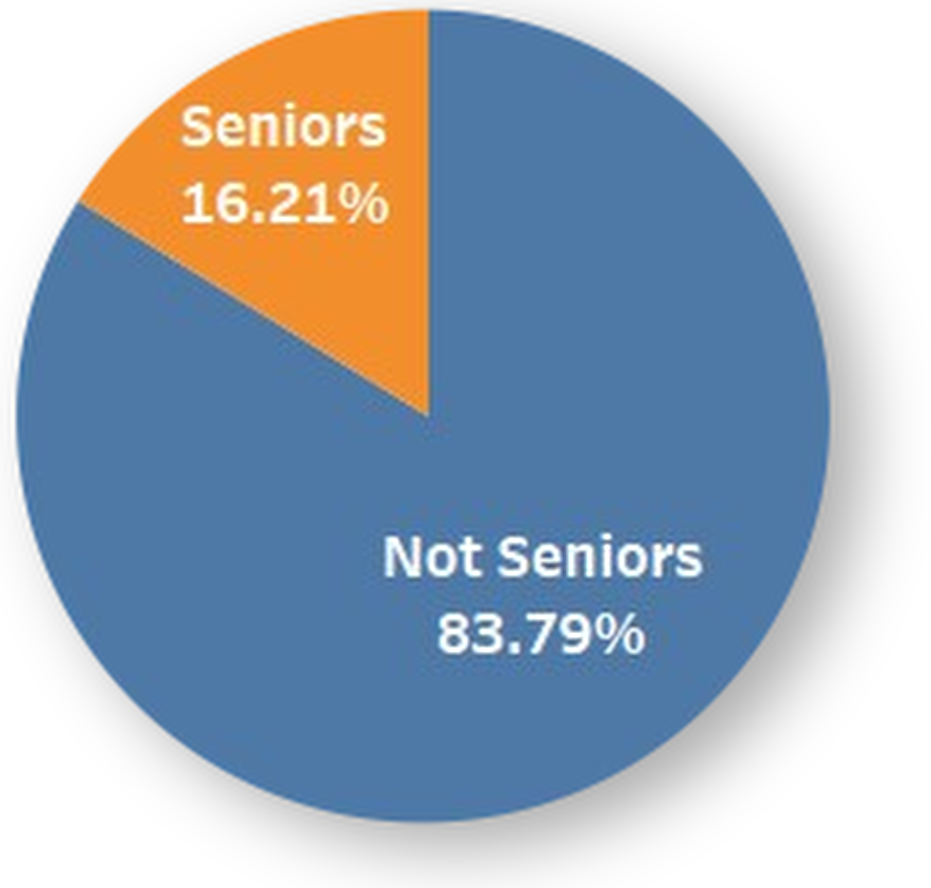
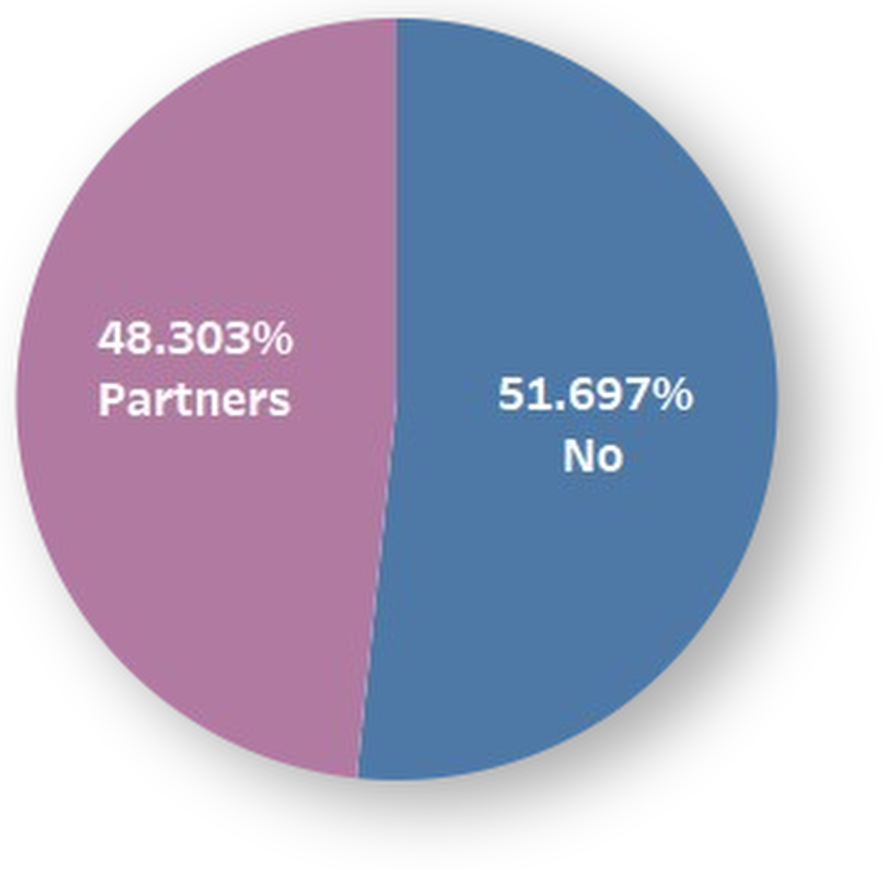
Who Are Our Customers?
3,555 men to 3,488 women
1,142 seniors to 5,901 non-seniors
3,402 partners to 3,641 non-partners

Slide 4
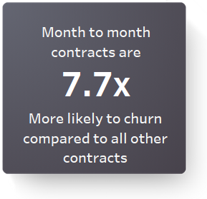
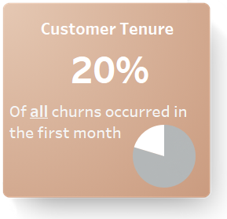
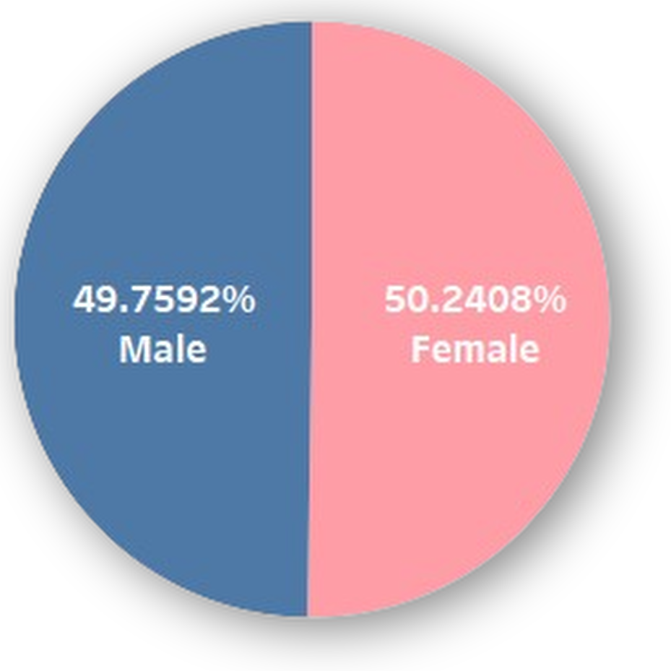
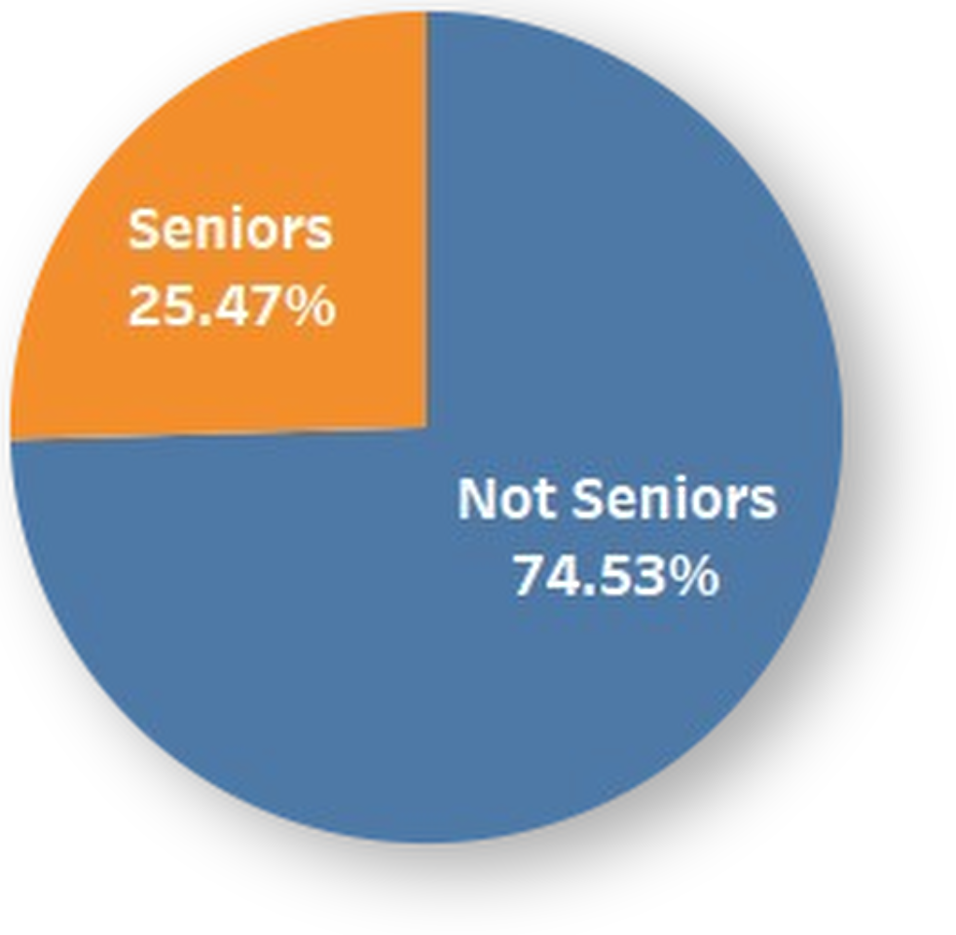
Who’s Leaving? (Churner Demographics)
Swan currently offers 3 types of contracts: month-to-month, one year, and two year
Out of 1,869 total churns. 1,655 were from month-to-month contracts — 89%
On average, customers are 4x less likely to churn when with Swan for more than 10 months
The balanced demographic of men and women barely changes when it comes to churning
Seniors represent about ⅙ of the database but account for ¼ of churns – as there are 1,142 seniors with 476 of them churning

Slide 5
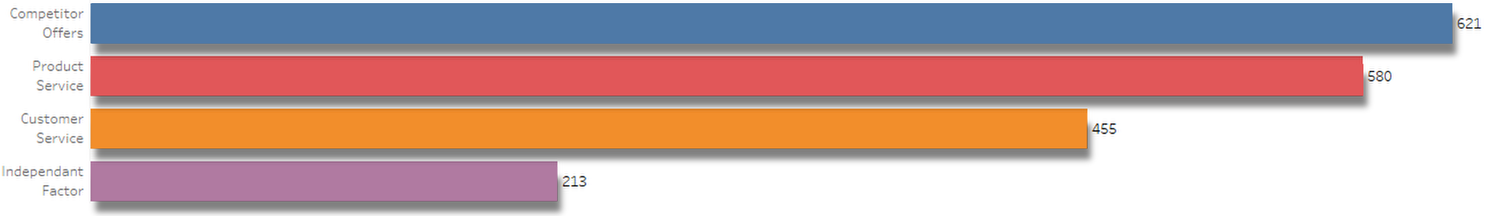
Why Are They Leaving?
There were various reasons as to a customers decision to churn. The chart above shows the top 4 reasons as to why they left.
Competitor offers seems to be the biggest reason for customers churning. This may coincide with a significant number of customers having low tenure months and month-to-month contracts
Poor product & customer service were other reasons as to why customers left, suggesting the team need to improve on this part to prevent more customers leaving for these reasons
Independent factors were reasons that were out of Swan Teleco’s control. This included customers that moved away, selected ‘Don’t Know’ as their reason for leaving and customers that are deceased. Any incentive is unlikely to work to reduce this

Slide 6
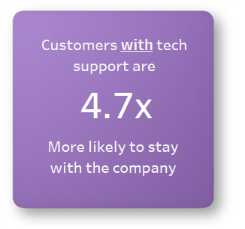
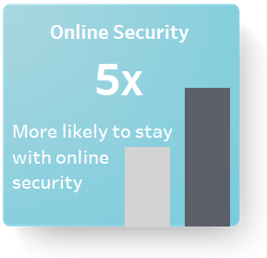
Who’s Staying? What Helps Retention?
Customers were 4.7x less likely to churn when tech support was available to them. This likelihood increases up to 22x at lower tenure months suggesting lack of tech support could be a factor for recent customers churning. This may link to many churners leaving due to poor product service
Customers were 5x less likely to churn when having online security. A similar trend follows like tech support with low tenure customers having a higher rate of churning. Lack of online security could cause customers to lose confidence and find service elsewhere which aligns with the competitor offers being the main reason for churning
It would be worth looking into incentivising these two metrics in order to retain any at risk churners

Slide 7
Summary
There is a balanced distribution of customers based on gender with the majority being non-senior citizens
89% of churners are on month-to-month contracts
Competitor Offers, Product and Customer service were the main reasons for customers churning
Incentivising tech support and online security could potentially prevent more customers churning for these reasons. Especially those who have recently began their contract

